Slide 1
3471 Project - Iteration 2
Runtime Terror:
Ashley Bickham, Joshua Hunter, Austin Lehman, Tyler Ross

Slide 2
Revised Analysis
This software that we are creating will be beneficial to those who use it because it allows for easy management of an online store’s inventory, permits the store to add or remove items, keep track of the total inventory that the store has, as well as monitor orders placed through the store. The system we create will supervise the store’s inventory, which will make it easier for employees to focus on other tasks in order to make the company as efficient as possible, since one of the main stakeholders of this project is the company, as well as its customers. The software should permit the customers to purchase items that are in stock, keep track of these items, and for the employees to restock items. The GUI included in the system lets a customer look up an item on the store by its ID number and will provide in return the stock of the item, a general description of the item, and the option for the user to purchase the item. This iteration of the project, we focused more on code and program development, as well as monitoring these changes through GitHub and documentation of our work. Through GitHub, we have all been able to work on similar files that are able to be changed collectively each time someone pushes a change to the website.

Slide 3
User Roles
Ashley-
Presentation / PDF Management
Package Diagram
Revised Analysis
Sale & Customer classes
Joshua-
Maven Project & Configuration
Project Lead / GIT Management
Presentation
PaymentInfo & SalesLineItem classes
Austin-
Implement JUnit tests
Swing GUI Lead
Website Maintenance
ShoppingCart & Item classes
Tyler-
Implement JUnit test
Design Class Diagram
ProductCatalog & ProductSpecification classes
All-
Store Class
Iteration 1 Revision
Use Issue Tracking system
GUI Implementation
Creation of Diagrams (SSD)
GRASP Pattern Identification

Slide 4
Project Implementation
The GUI is separated into two main view classes. The first view class NozamaView is the main page of the store that shows its available items. NozamaModel is a model class that models the table that appears in NozamaView, as well as handles many of the operations in NozamaView. The second view class is ShoppingCartView, which shows the contents of the customer’s shopping cart as well as it’s subtotal and a checkout button. Like NozamaModel, ShoppingCartModel is a model class that handles the data and operations for ShoppingCartView.

Slide 5
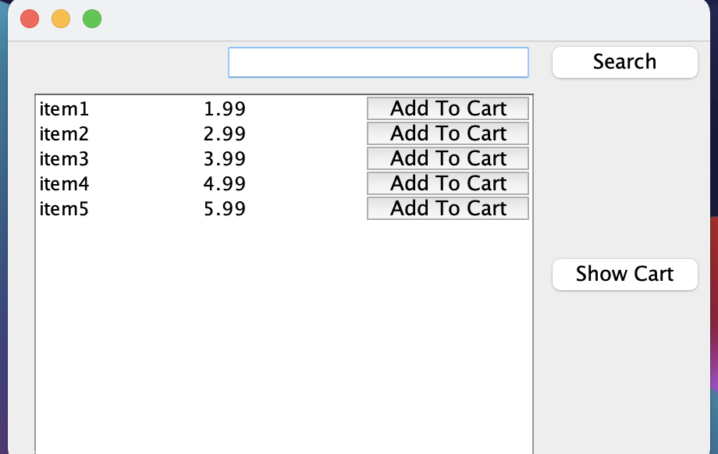
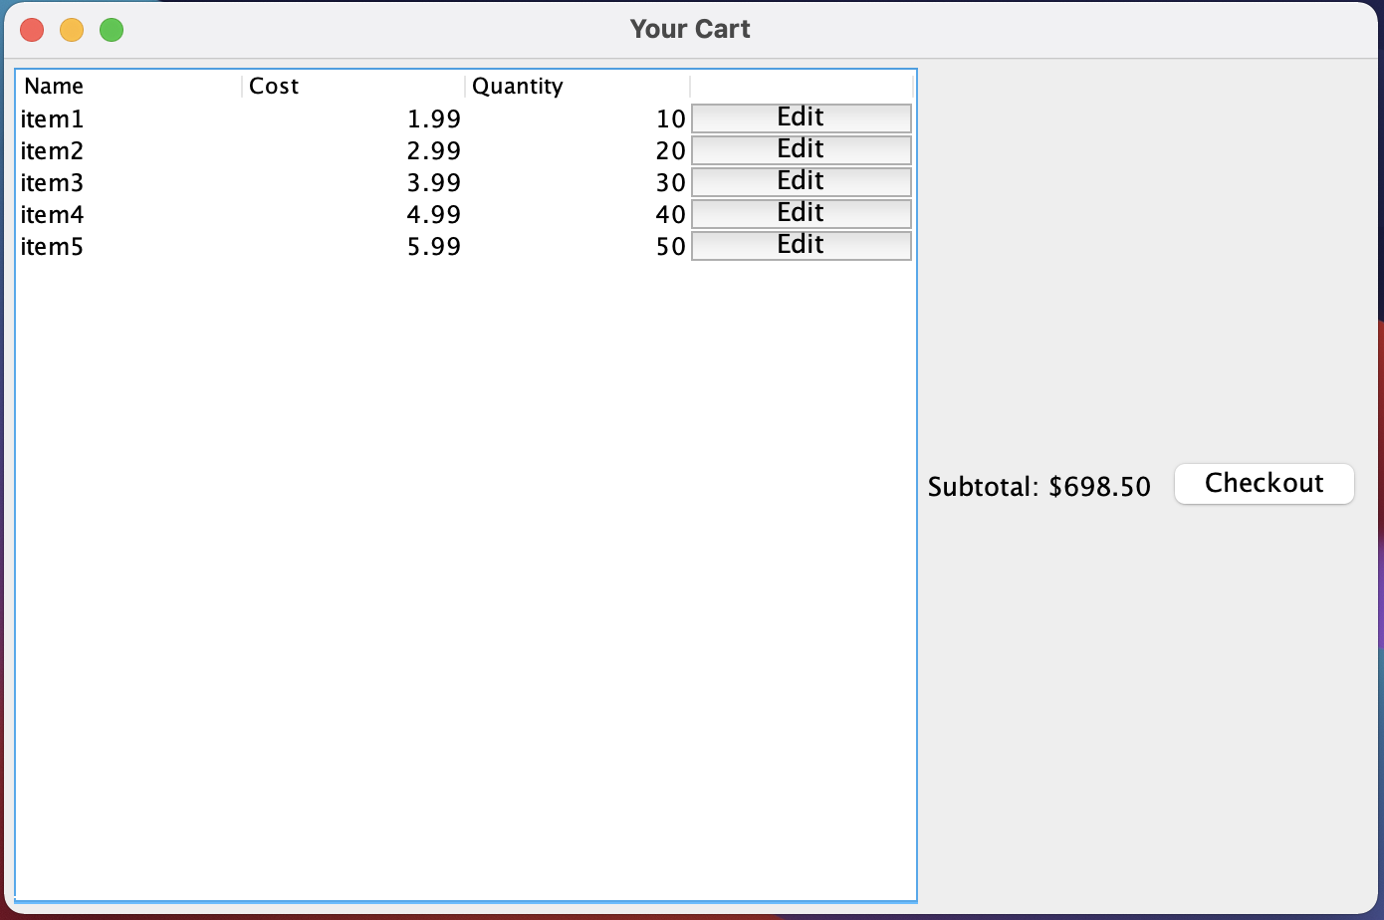
Prototype

Slide 6
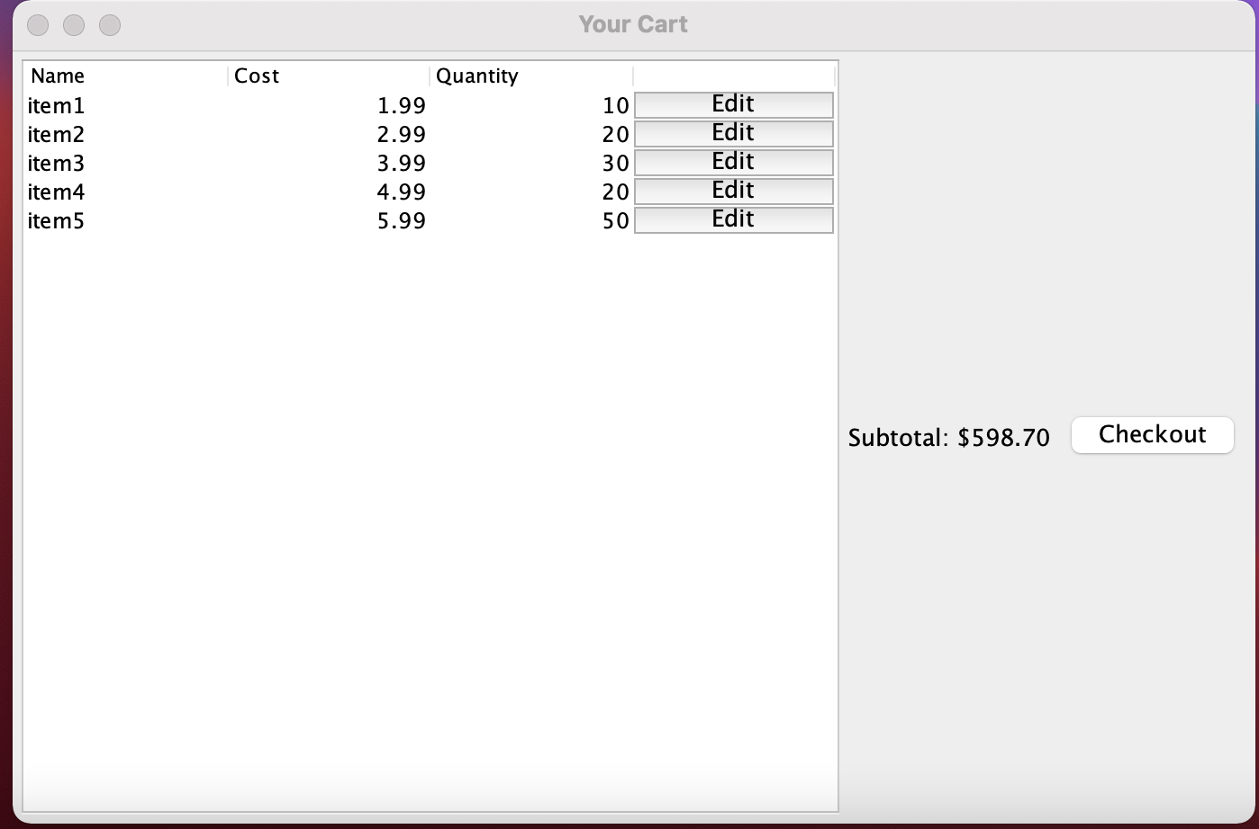
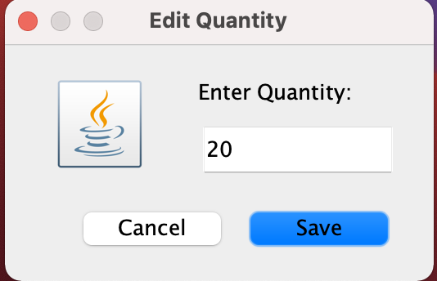

Slide 7
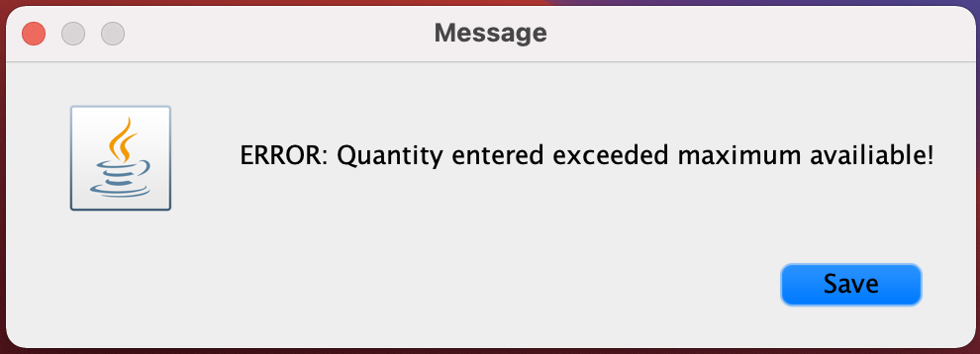
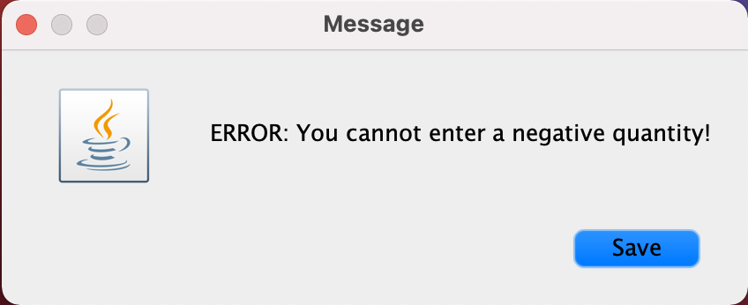

Slide 8
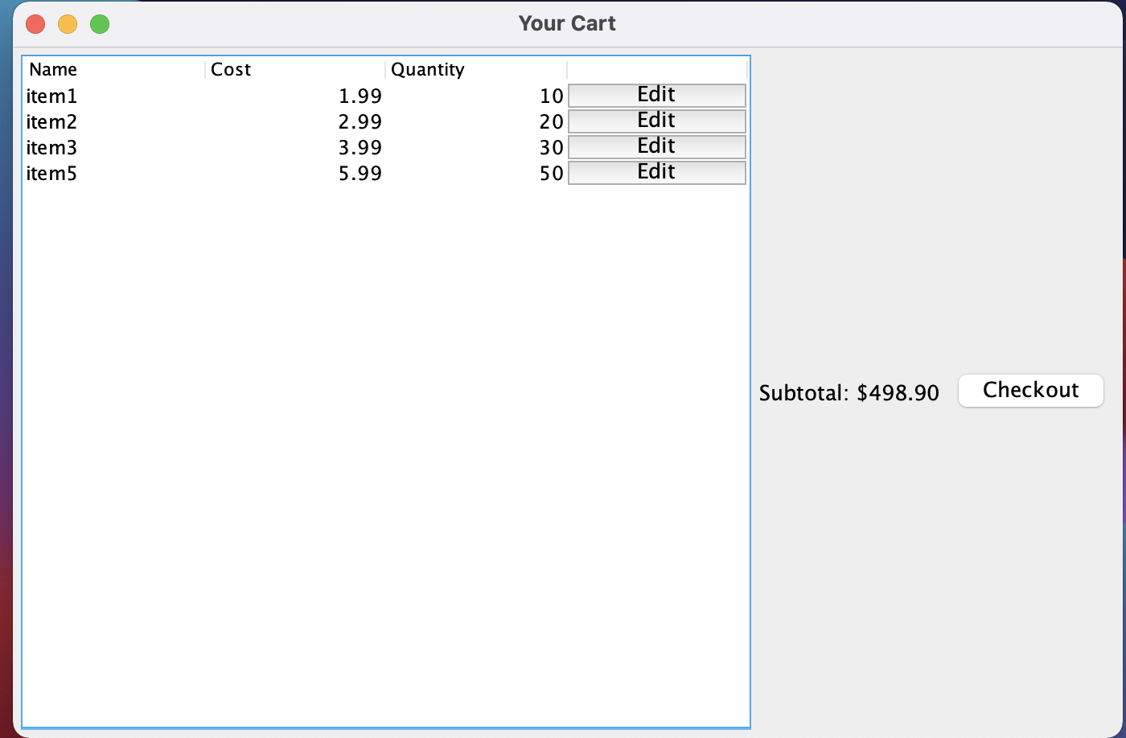
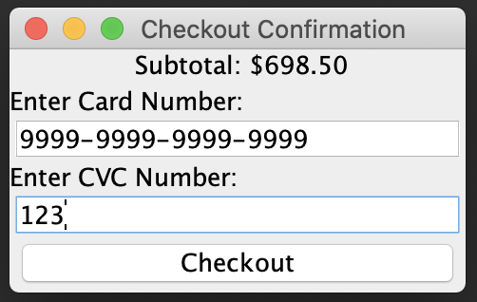

Slide 9
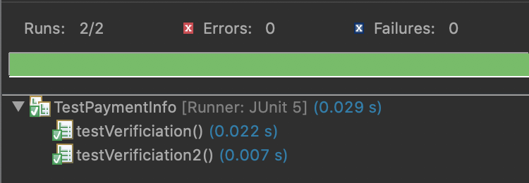
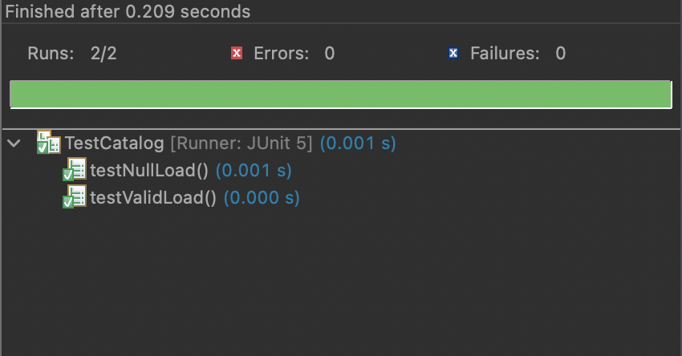
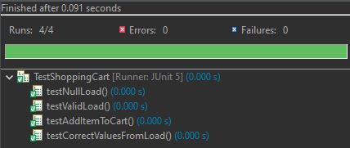
Testing
Still working on fully implementing all tests

Slide 10
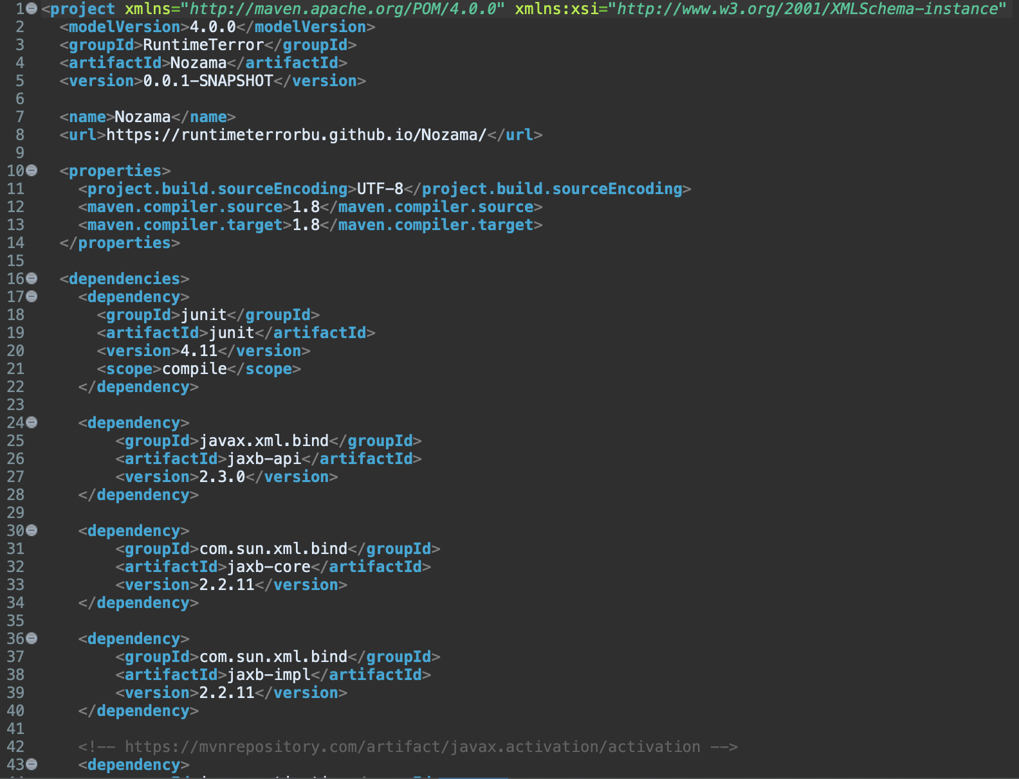
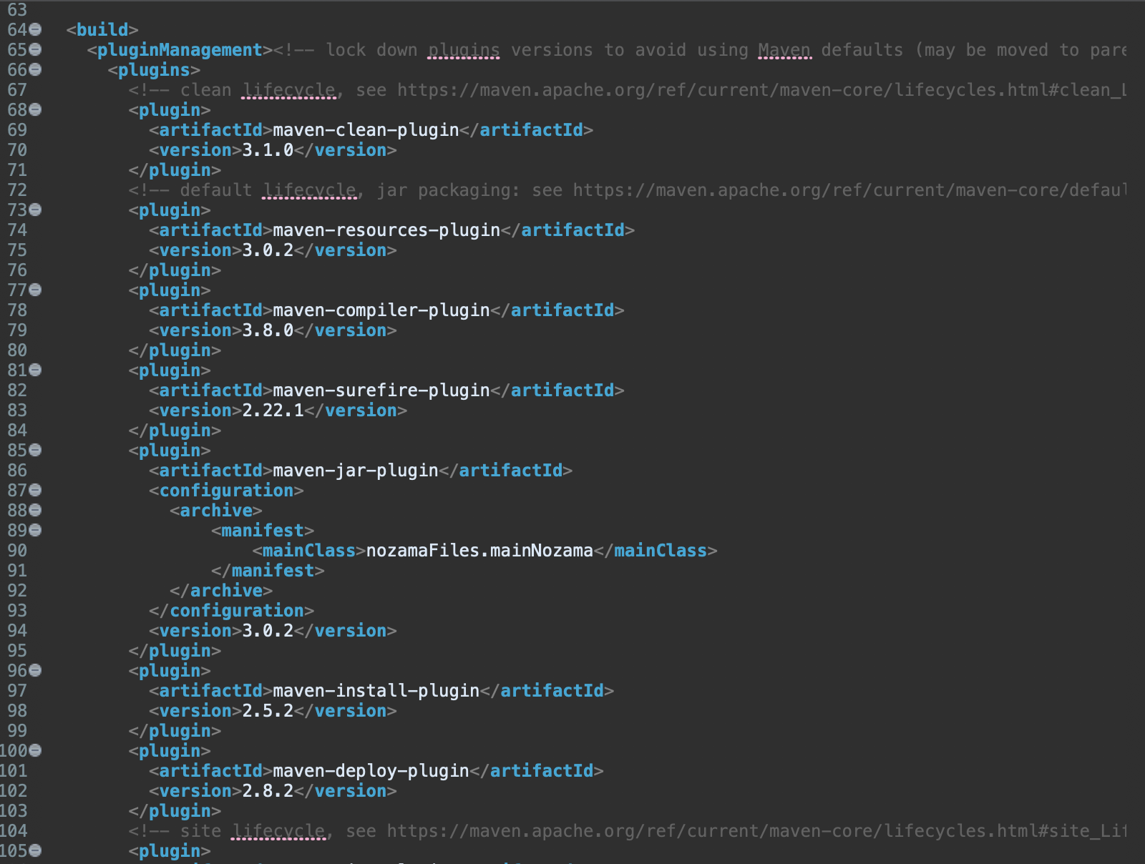
Maven

Slide 11
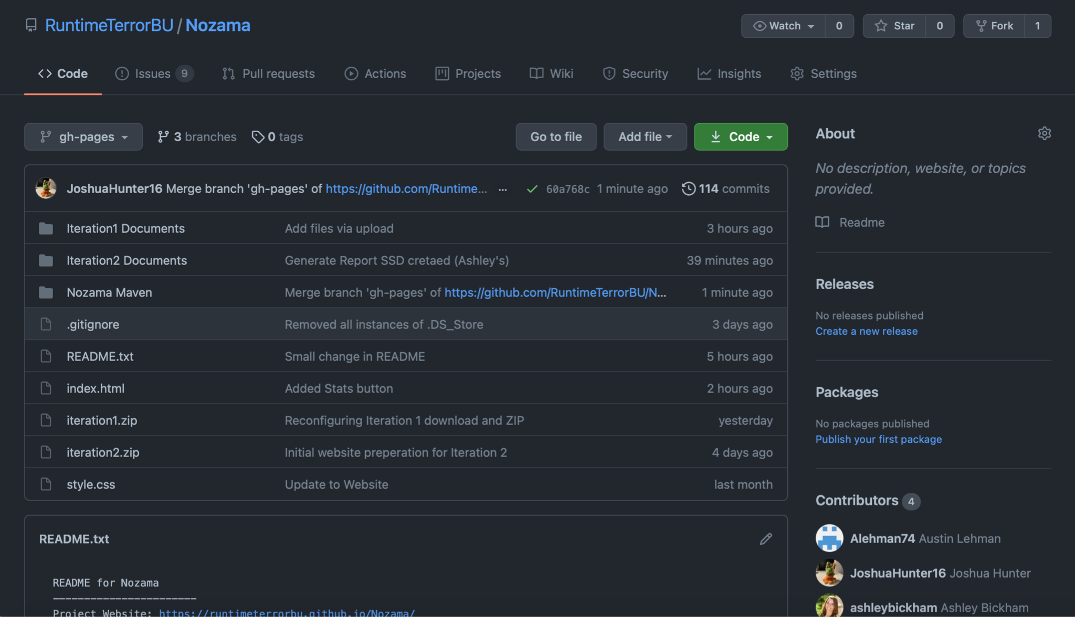
GitHub

Slide 12
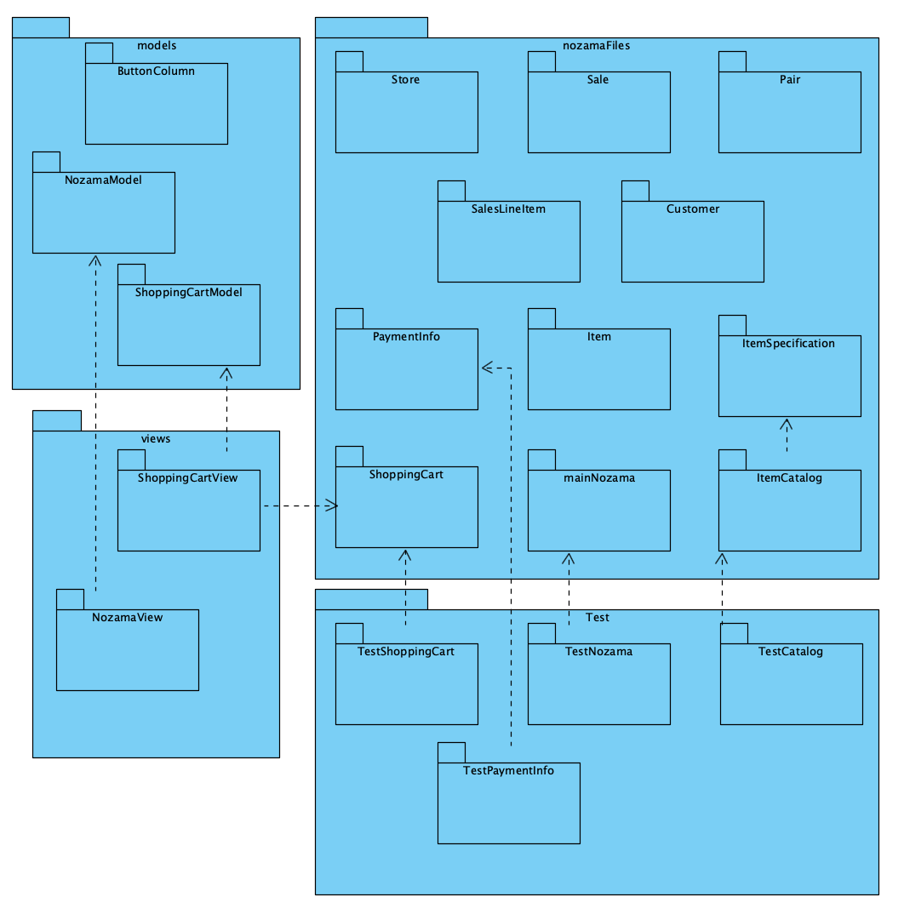
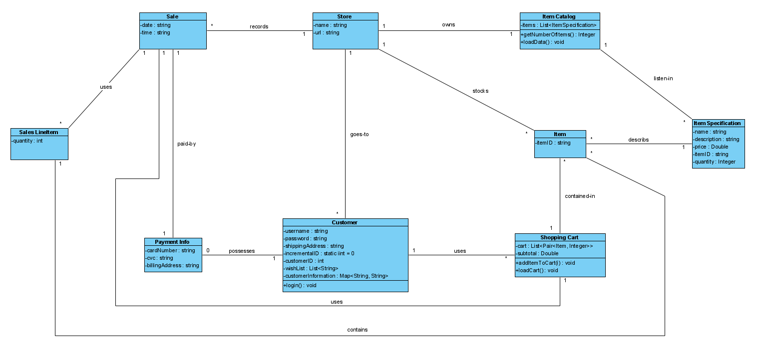
Diagrams
Package: Design Class Diagram:

Slide 13
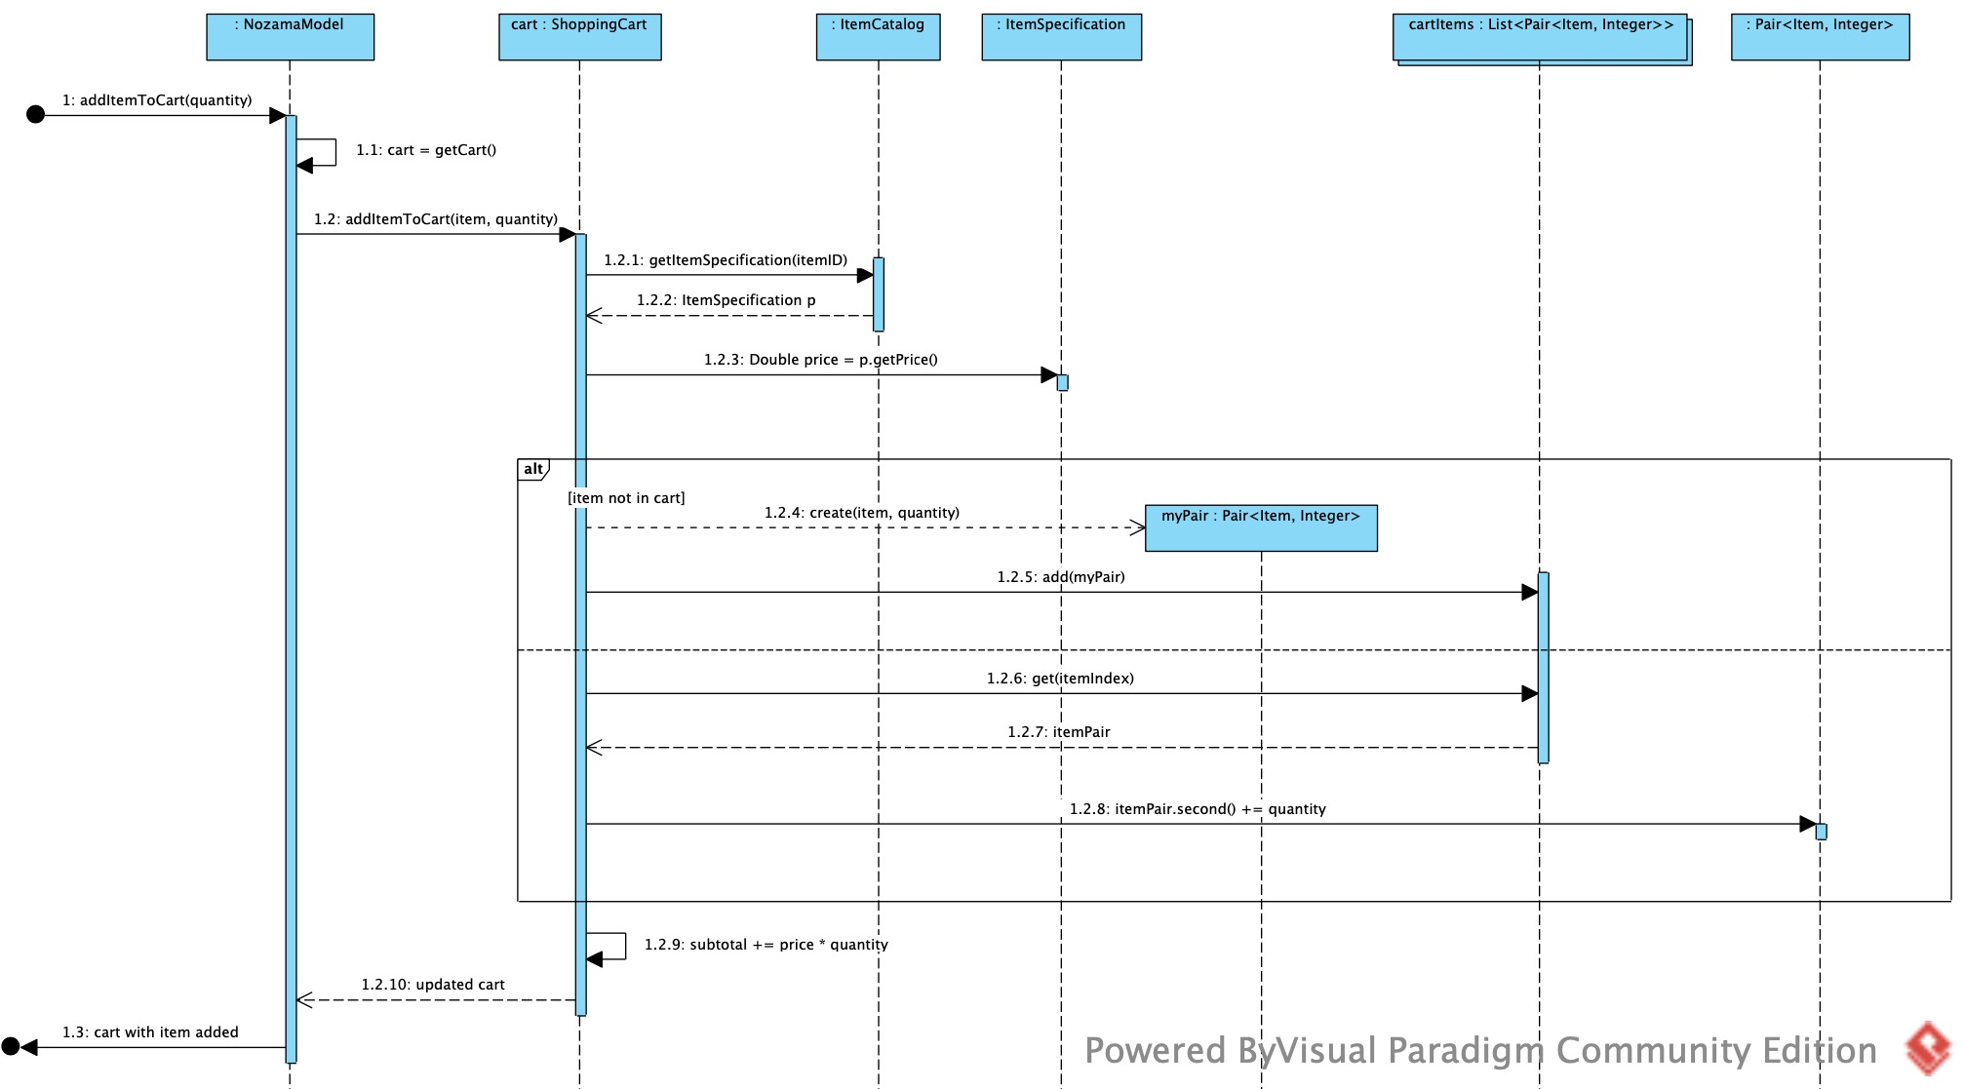
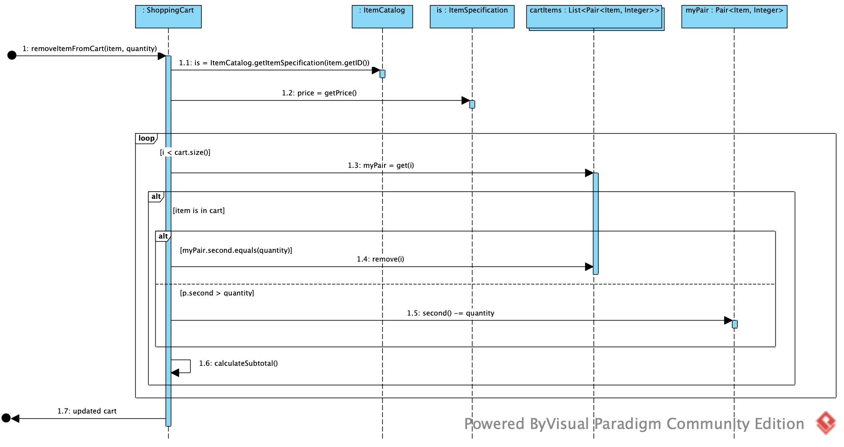
Add Item from Cart Remove Item from Cart

Slide 14
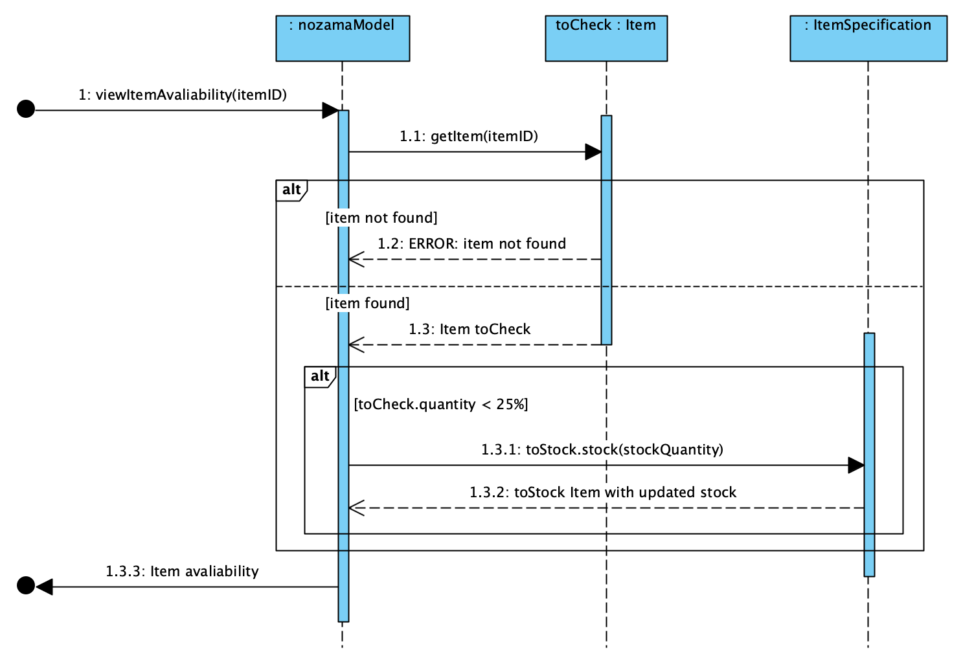
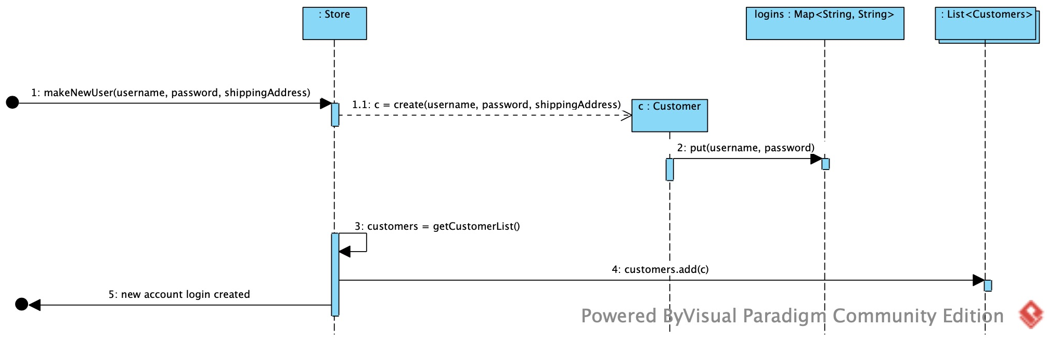
View Availability
Make New Account

Slide 15
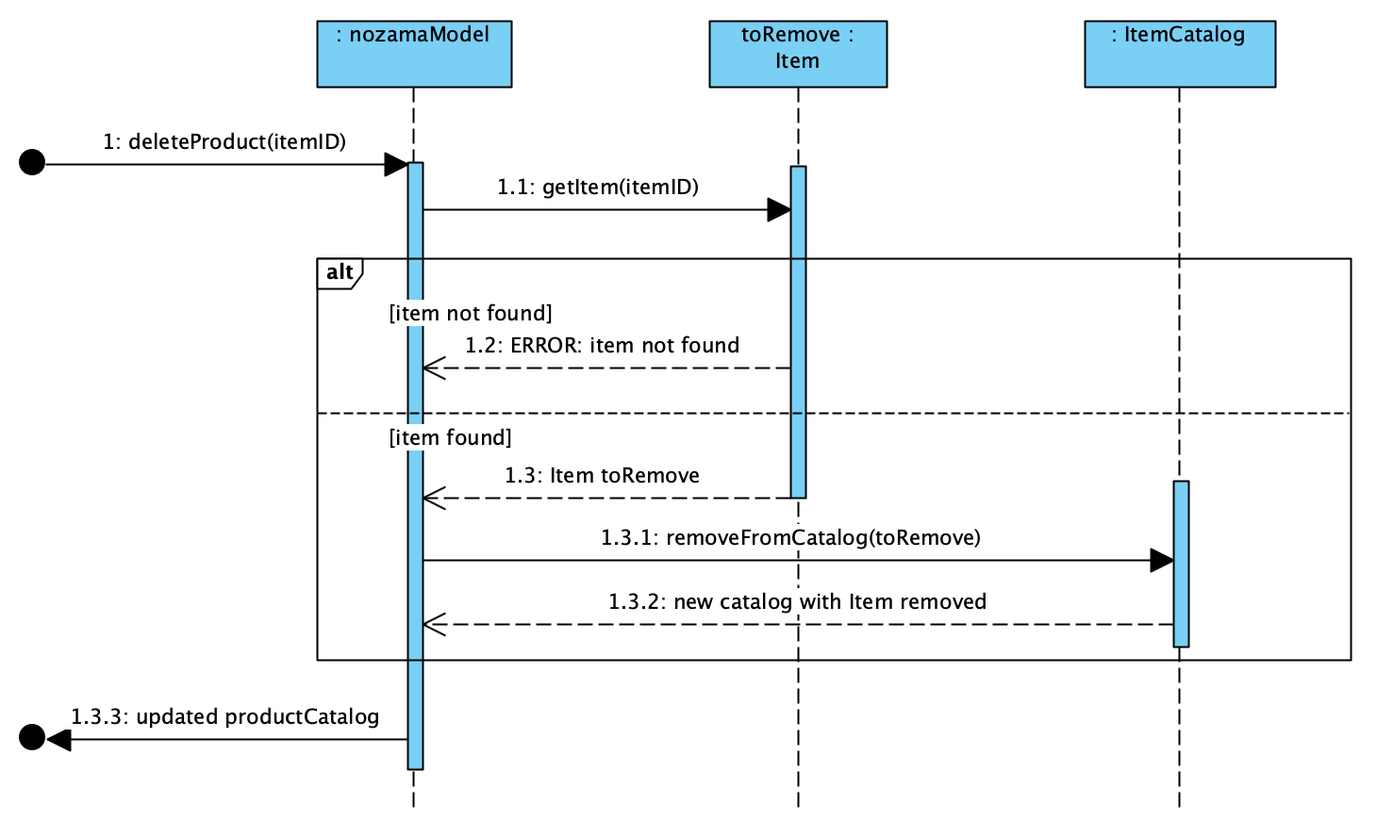
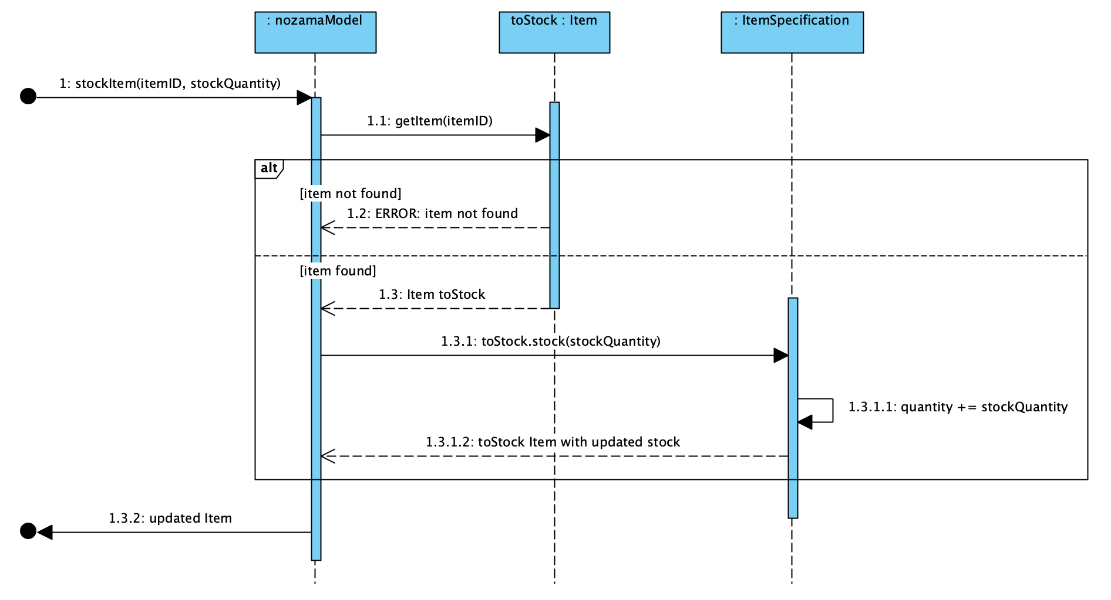
Delete Product Stock Item

Slide 16
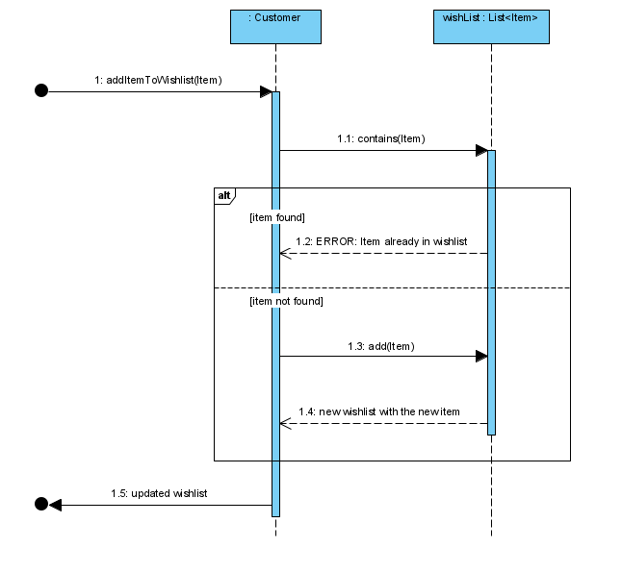
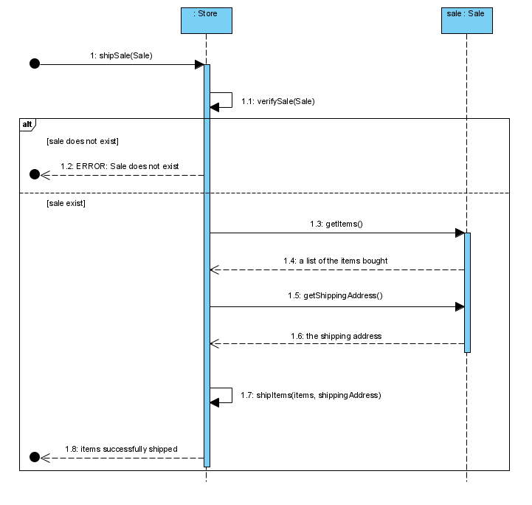
Add Item to Wishlist Ship/Send Item

Slide 17
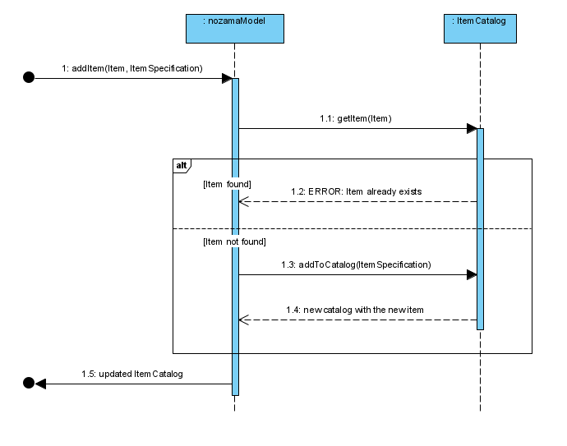
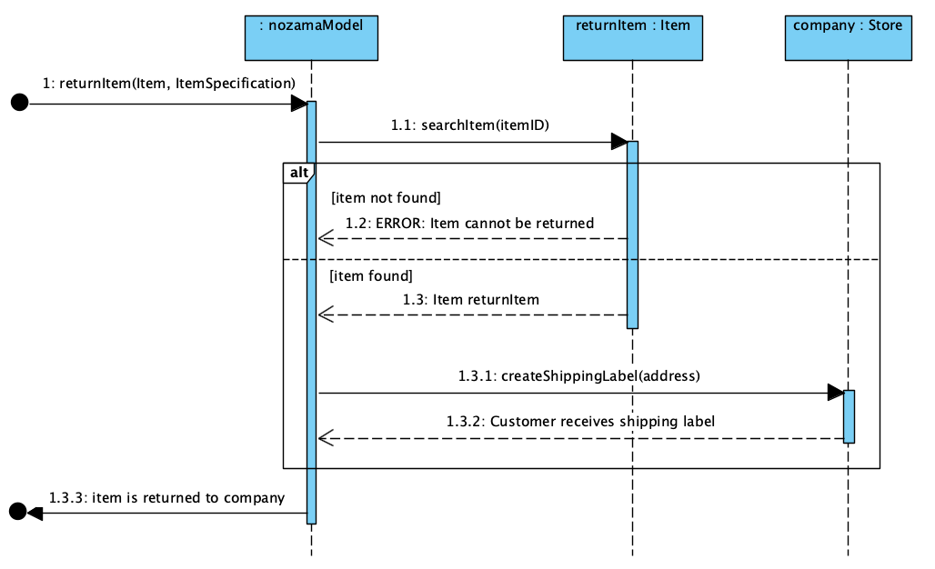
Add New Product Make Purchase

Slide 18
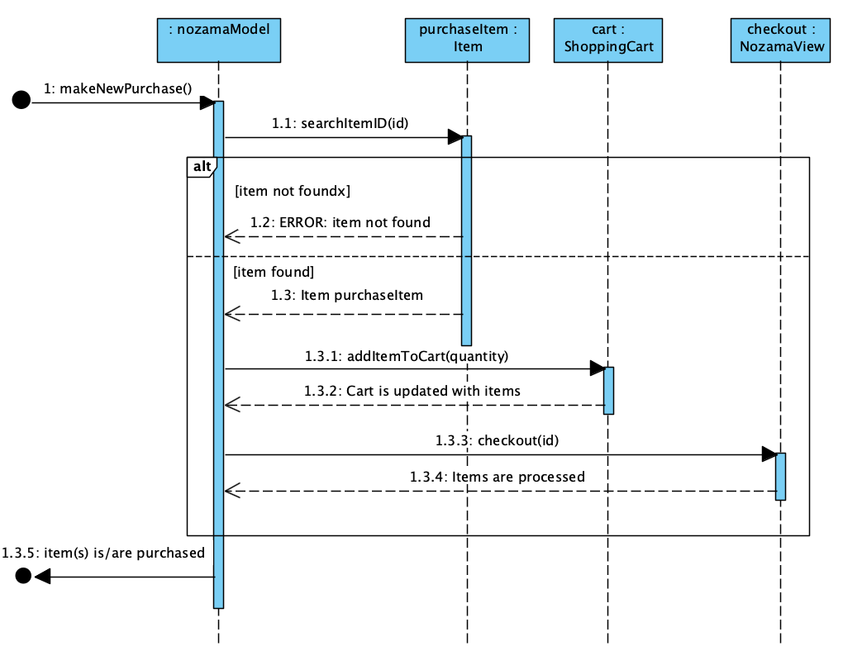
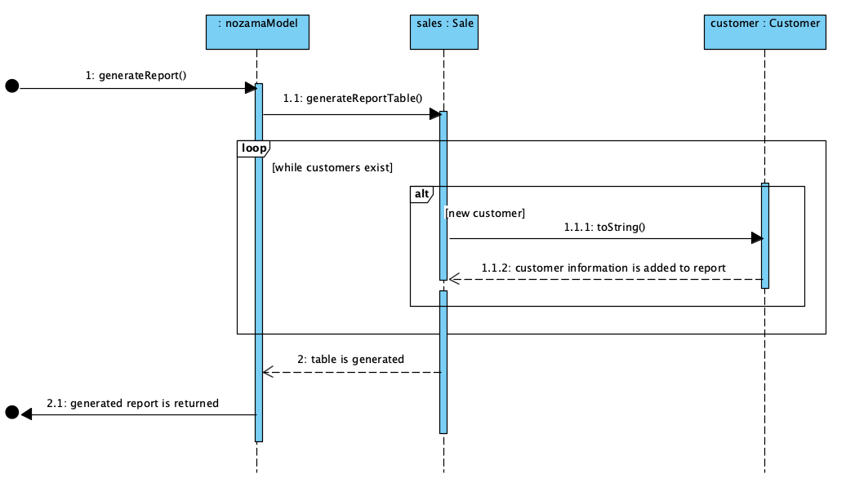
Return Item Generate Report

Slide 19
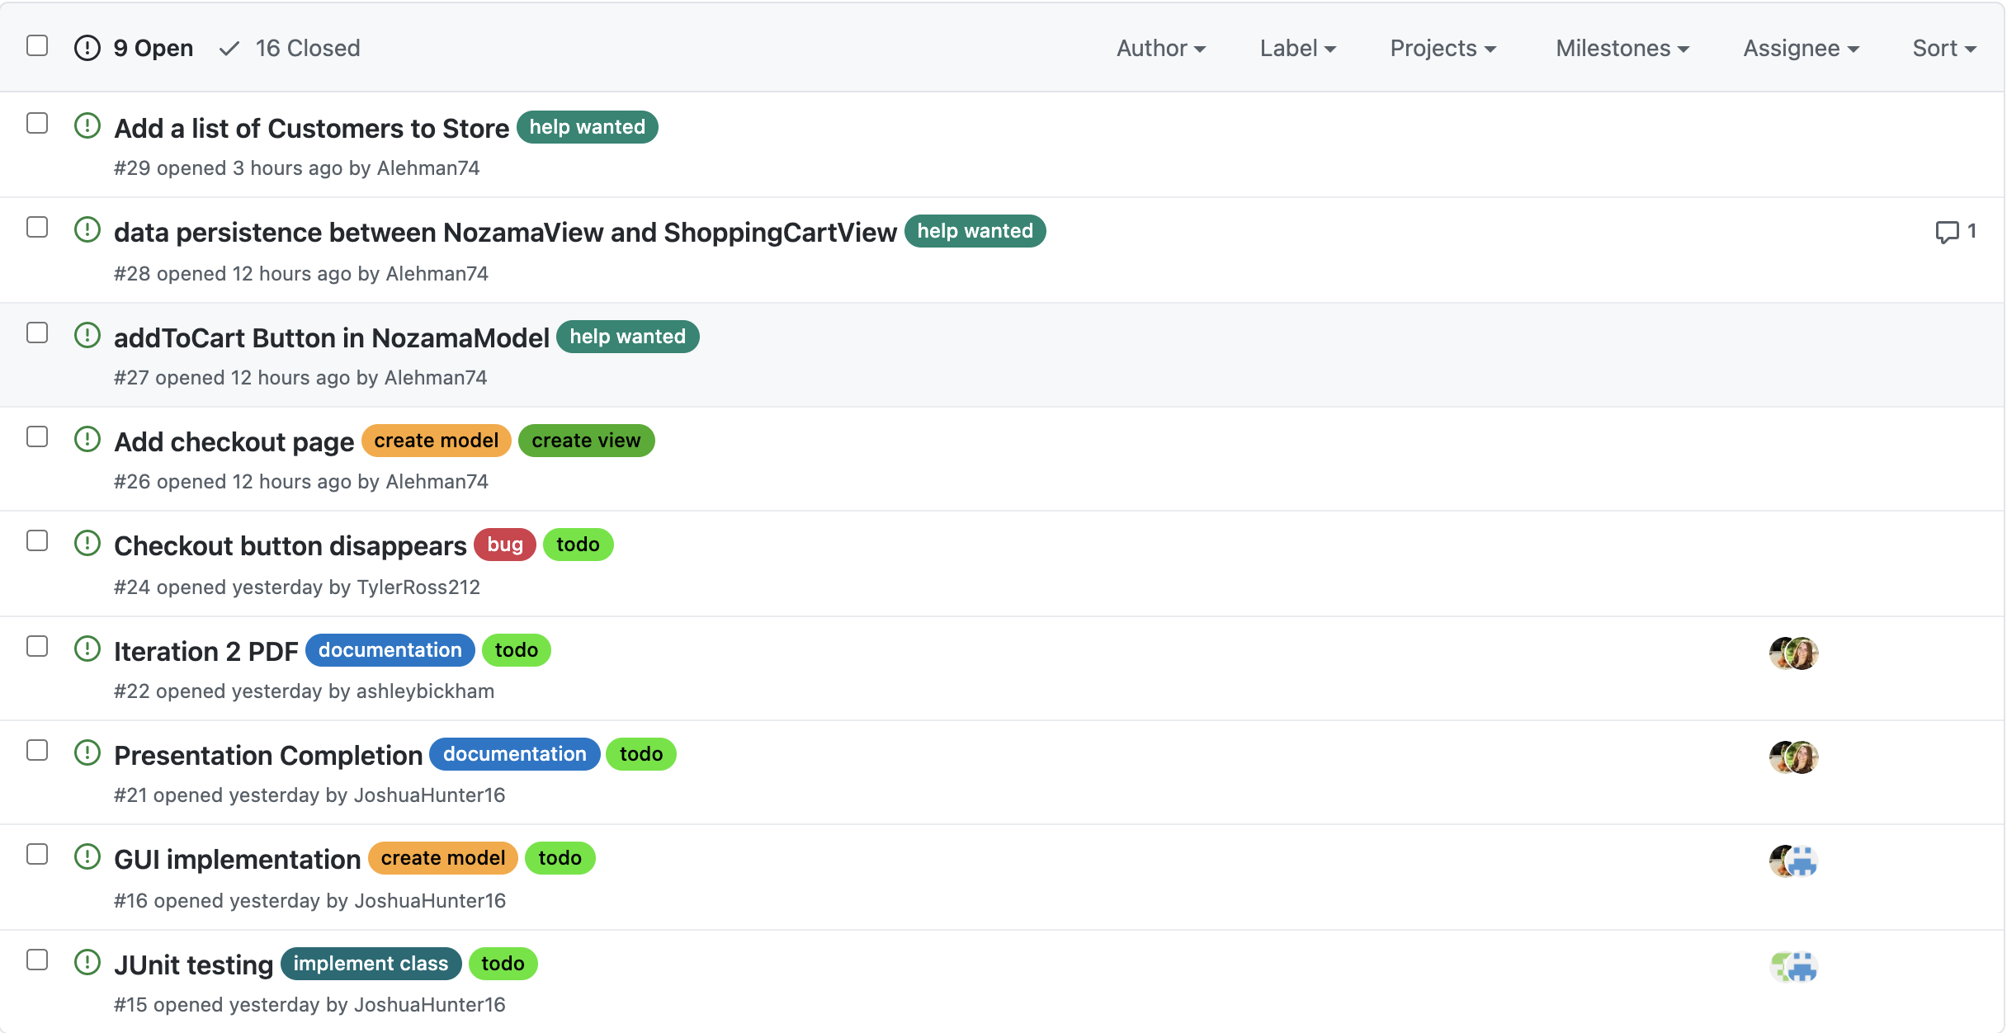
Ticketing Issues (Open)

Slide 20
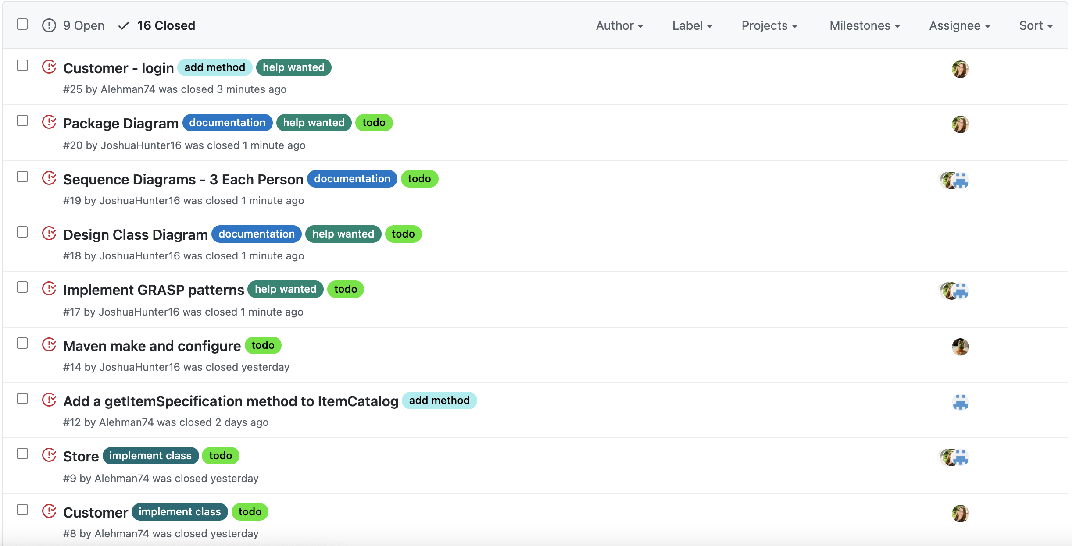
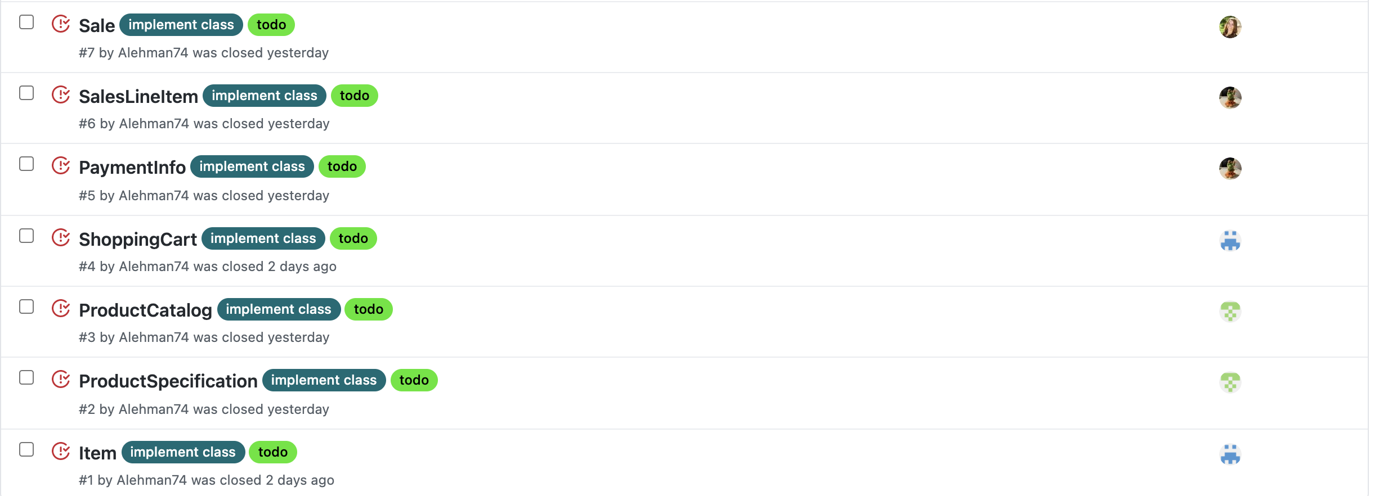
Ticketing Issues (Closed)

Slide 21
GRASP Patterns
Creator:
Sale is a creator for SaleLineItem objects
Controller:
NozamaModel is a controller for NozamaView
ShoppingCartModel is a controller for ShoppingCartView
Indirection:
ItemCatalog is used to separate Item and ItemSpecification

Slide 22
Website & GitHub
Website - https://runtimeterrorbu.github.io/Nozama/
GitHub - https://github.com/RuntimeTerrorBU/Nozama

Slide 23
Hours Worked by Each Member & Number of Commits
Ashley- 23 hours, 20 commits
Joshua- 27 hours, 29 commits
Austin- 29 hours, 33 commits
Tyler- 21 hours, 10 commits
119 Total Commits

